Slide 1
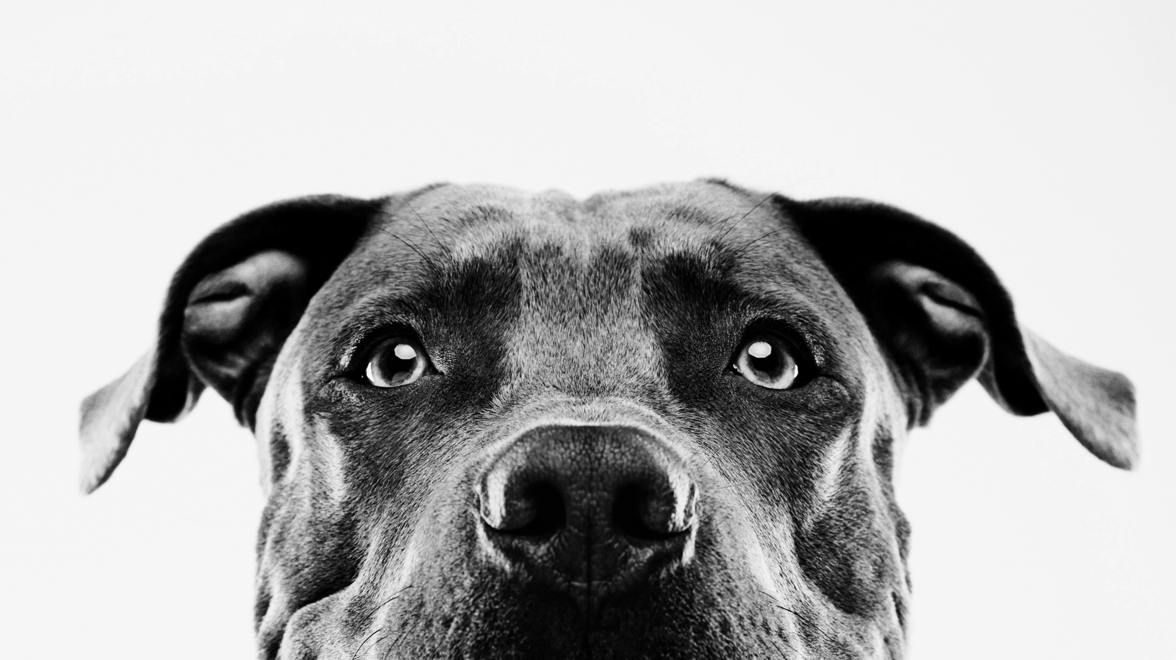
Animal-Explorer
Group project one

Slide 2






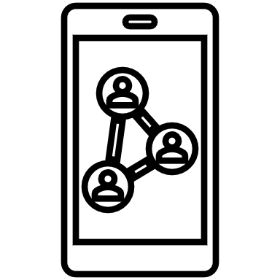




Elevator pitch
A web application with a simple, yet playful user interface that gets children, age 2 and above, excited to learn about the animal kingdom and interacting with technology.

Slide 3
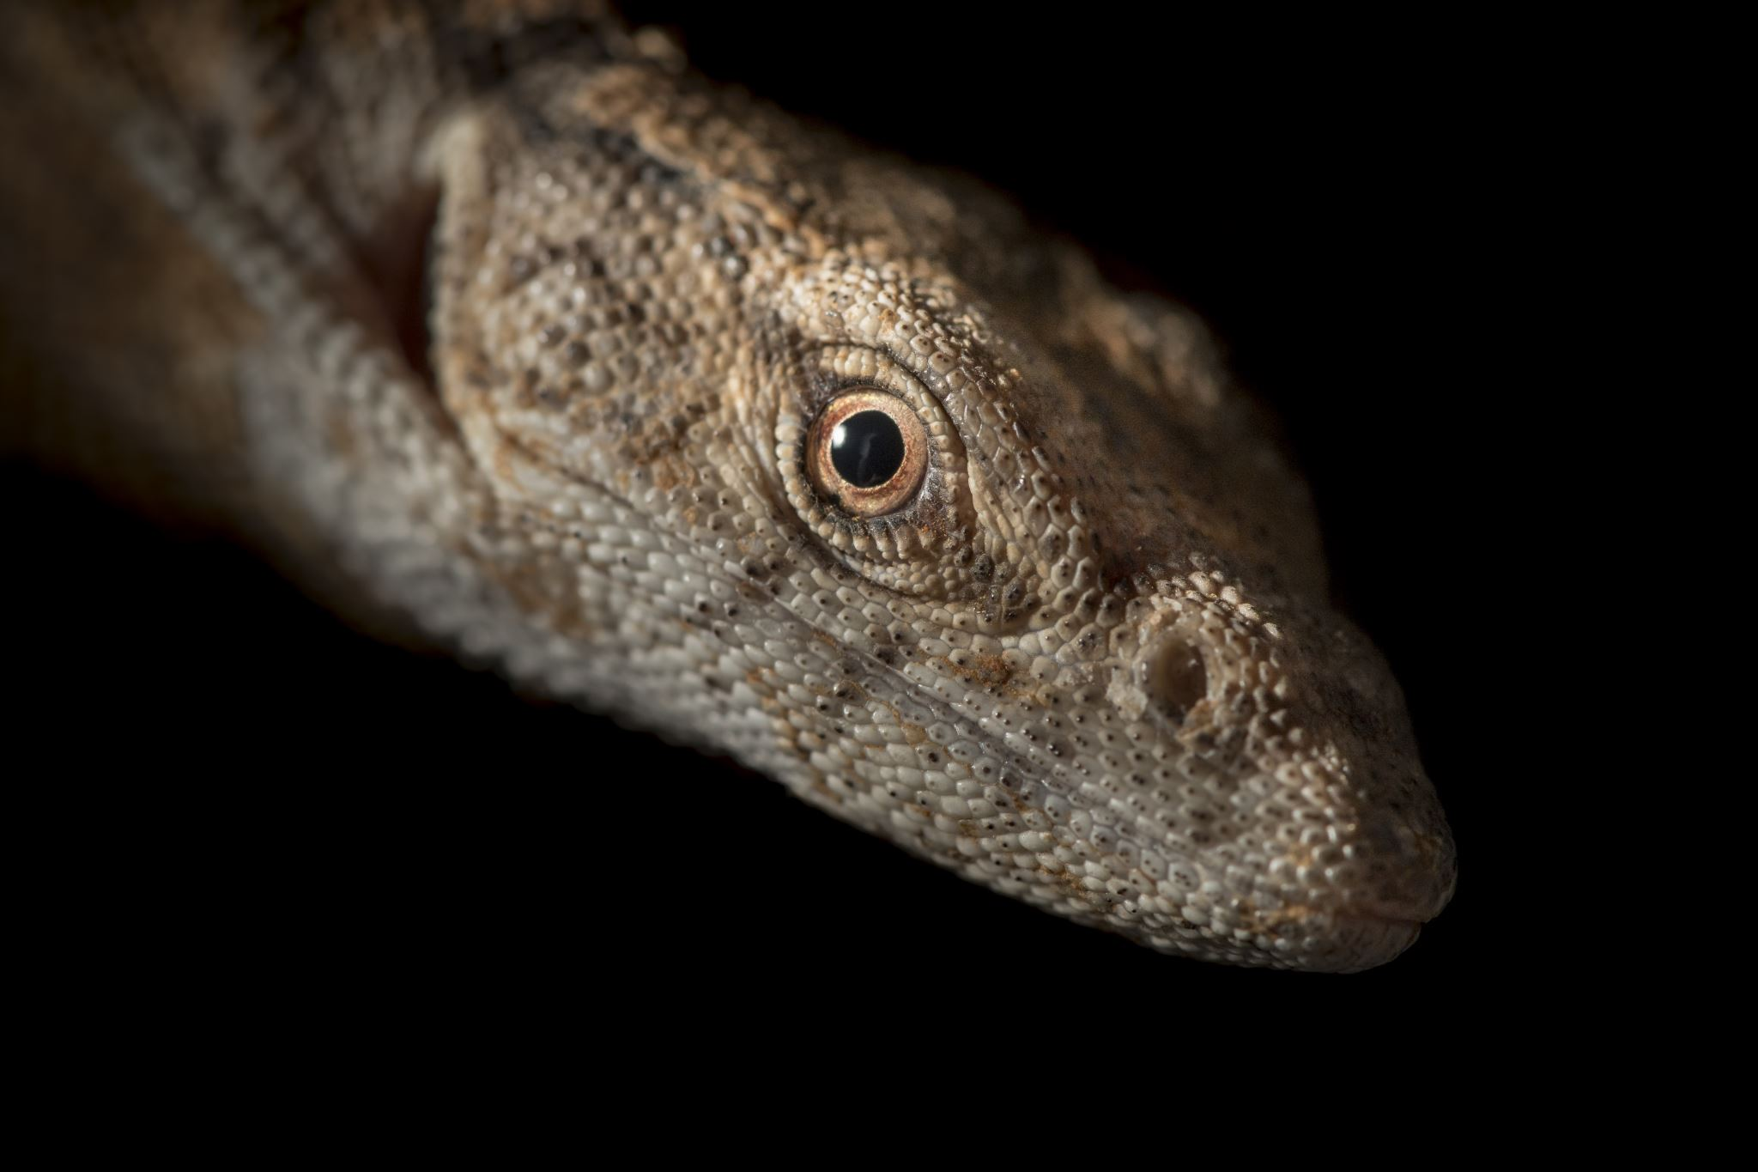


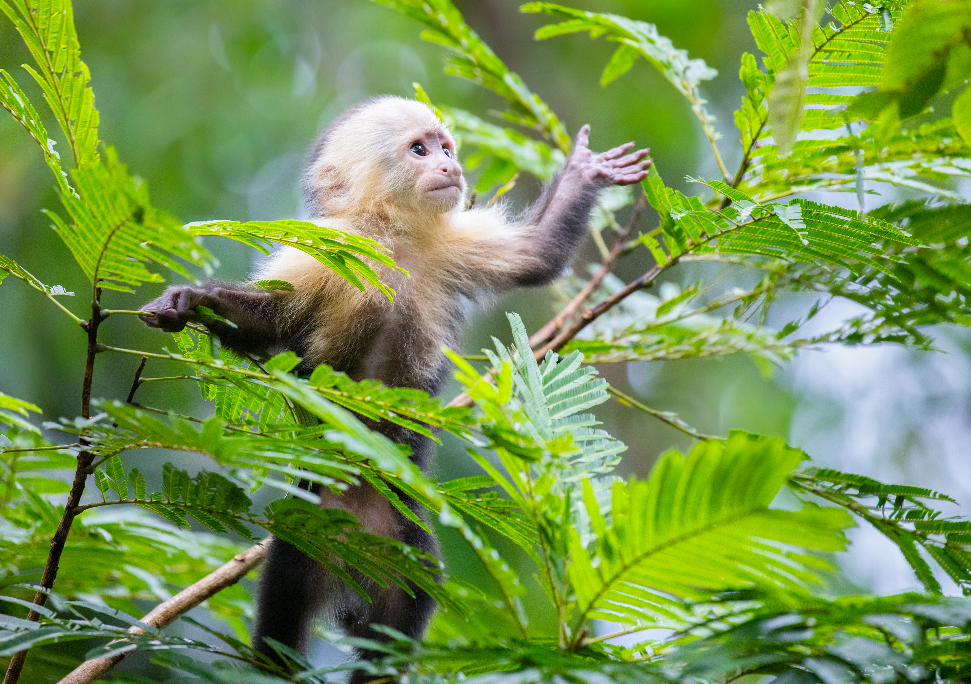
Concept
User Story:
As a child, I Want to click a highly visible and identifiable start button.
Then I am presented with images and text representing various animal classes.
When I click on one of the images I am presented with another set of images and text representing various species in that class.
When I click on an image, I am presented with a Wikipedia article related to that species as well as several images. I also have the option to view previously searched animals and to start a new search
Utilizes Wikipedia, Giphy, and Pixabay APIs to display animal related articles and images using dynamic html.
Our team endeavored to build an application that would provide value to the greatest number of people possible. Animals are fun for kids and adults around the world!

Slide 4
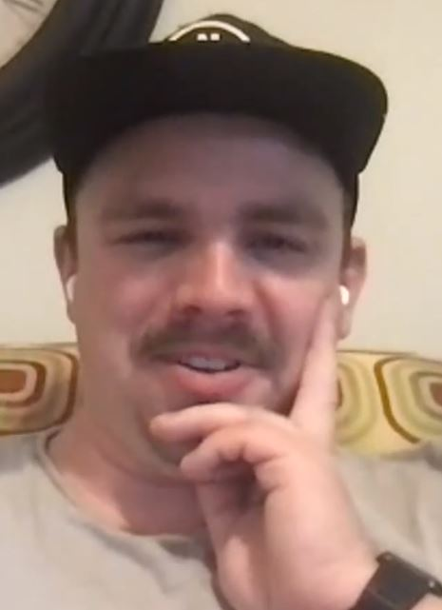
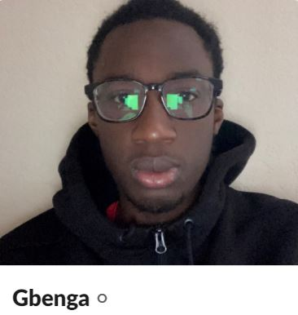
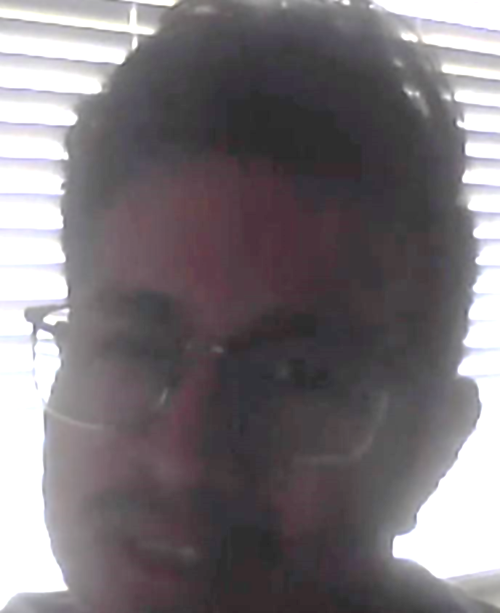

Meet the team:
Will
Role: Backend - jQuery/API
Special skills: Saving the frontend team when they don’t know what they’re doing.
Gbenga
Role: Frontend – HTML/Bulma
Special skills: Linking multiple HTML pages.
George
Role: Backend – jQuery/API
Special skills: Working on the project while attempting to enjoy his Florida vacation.
Rob
Role: Frontend – HTML/Bulma/CSS
Special skills: Ideas, mobilizing, and rabbit-holes

Slide 5
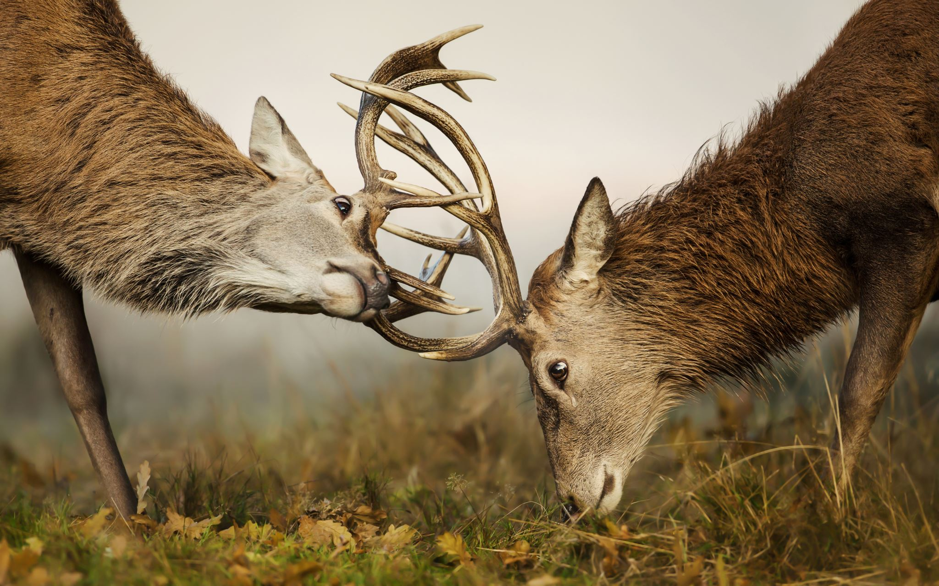
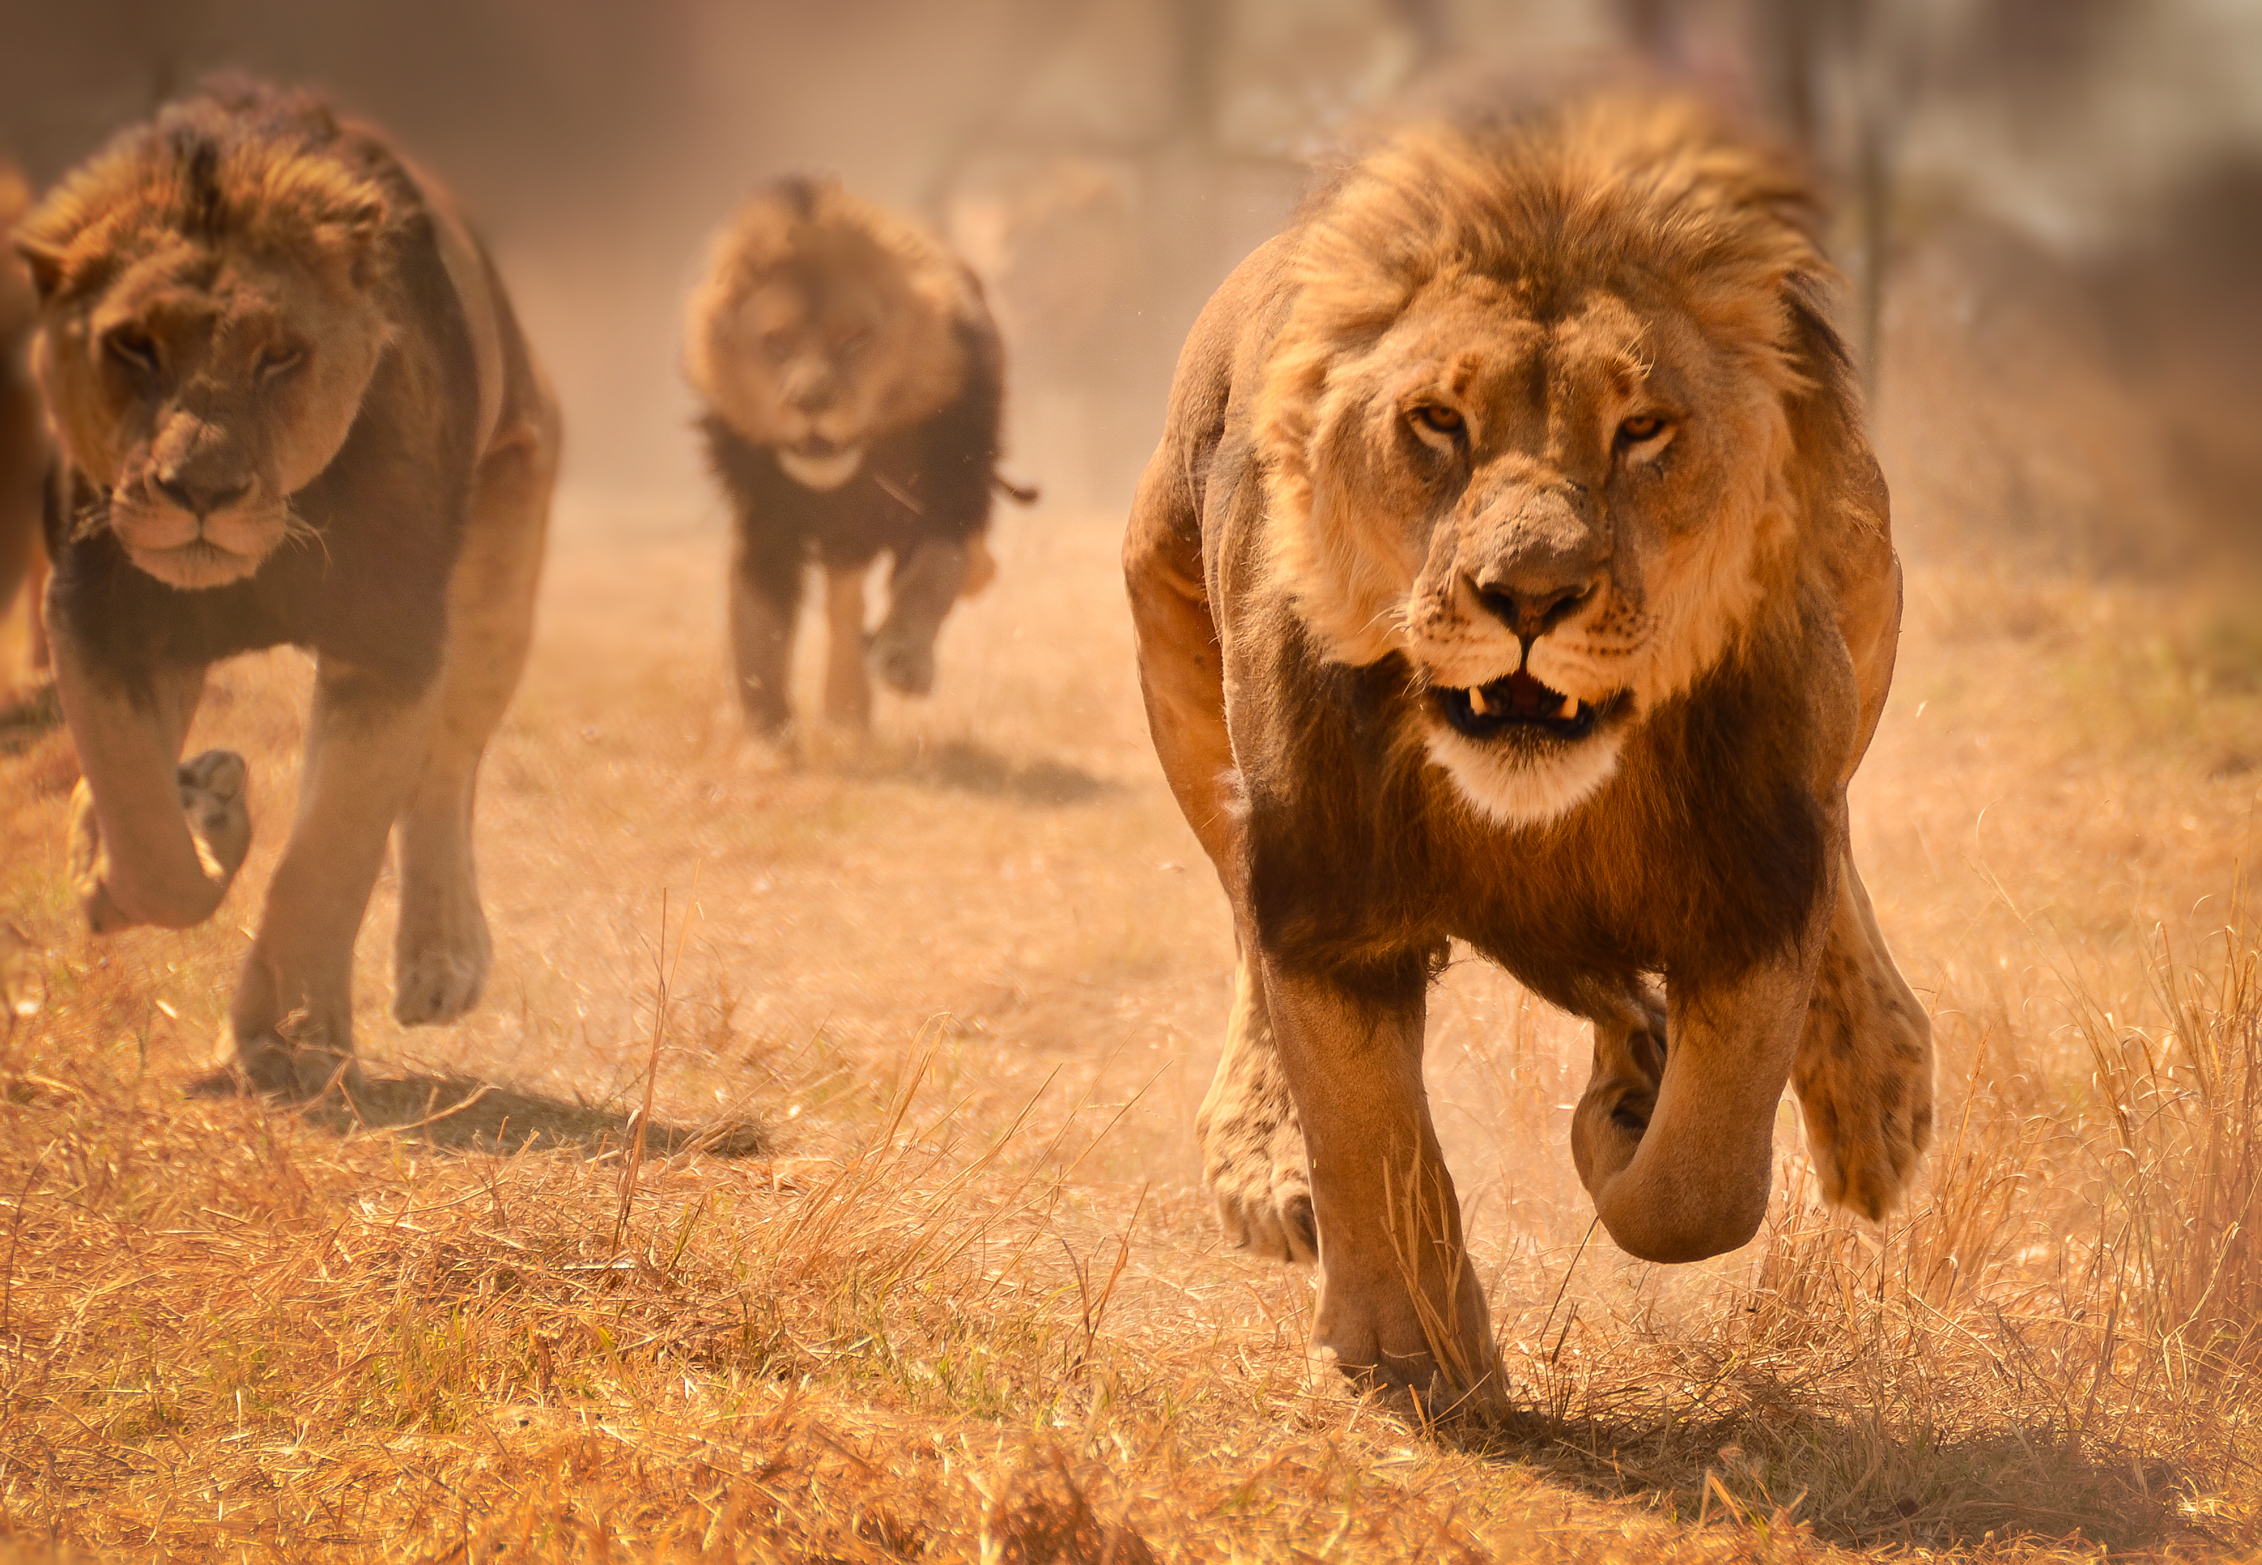
Challenges
Successes
Defining exactly what HTML elements need to be included in the index.html file, and which ones will be created dynamically using jQuery.
Keeping branches concise and sanitary.
Knowing when to give up on a particular framework style and create custom classes instead.
Zoom meetings were attended by each group member regularly.
The color scheme looks great.
Most functions work as expected.
Most would agree that the experience gained through this project is priceless.
Experience gained through this project will prepare us to succeed on the next project.

Slide 6
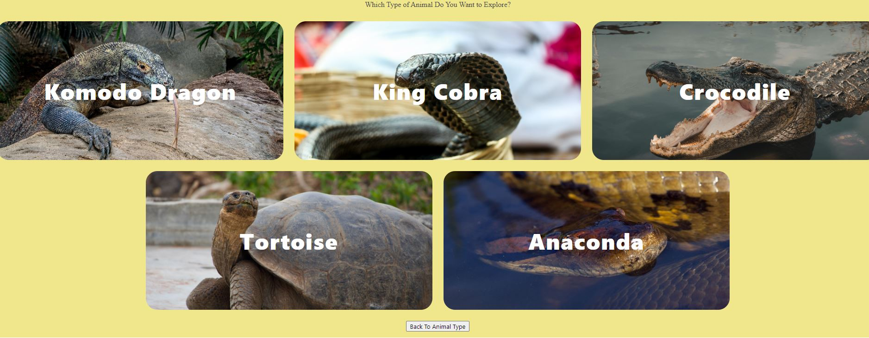
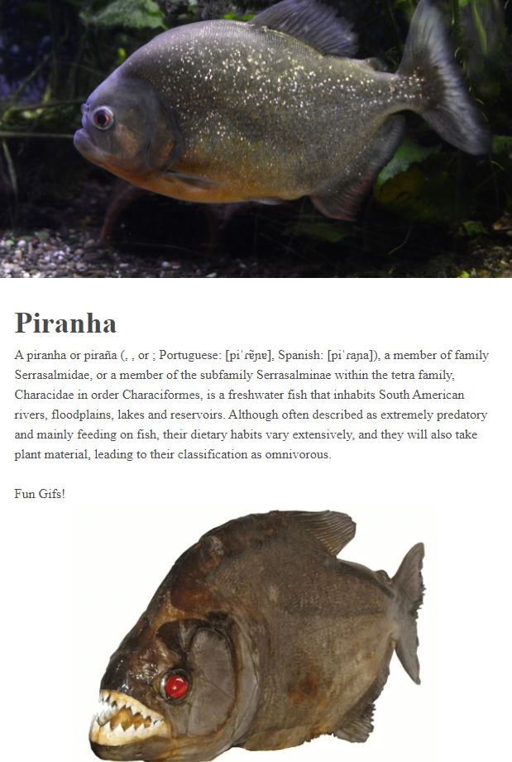
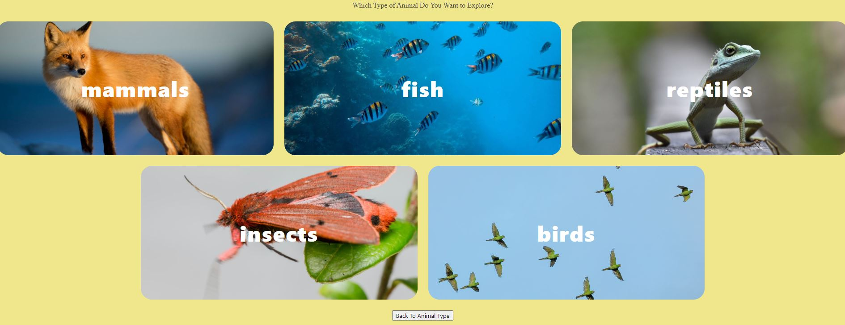
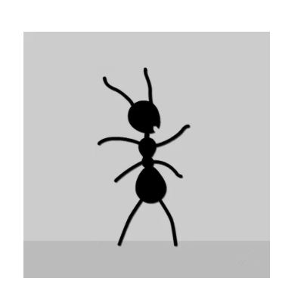
It’s showtime!

Slide 7
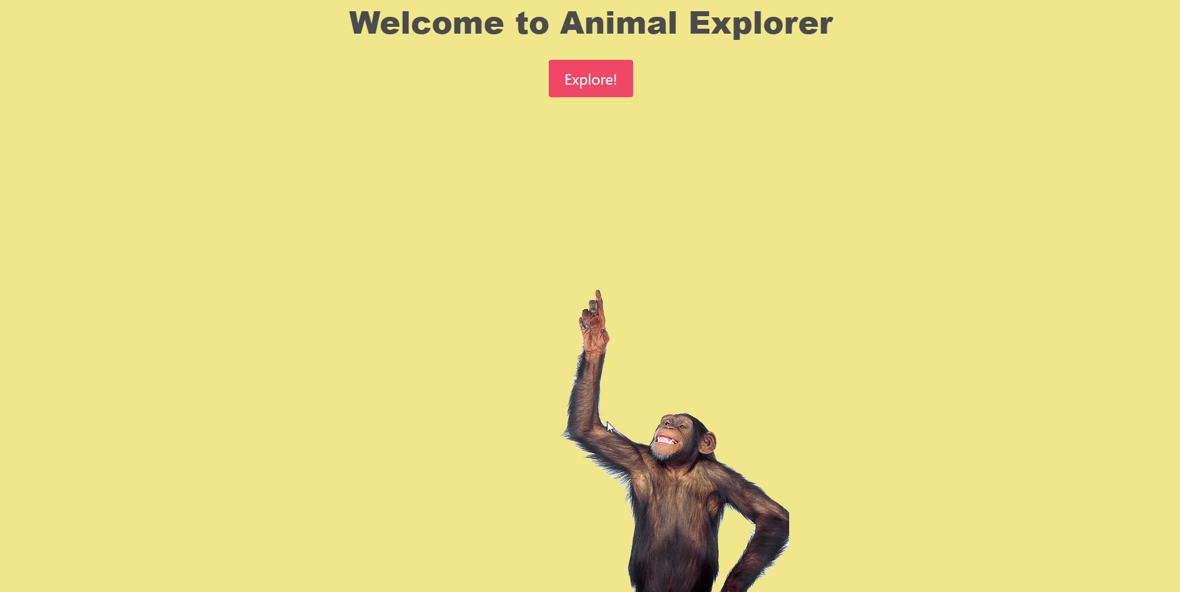

Slide 8
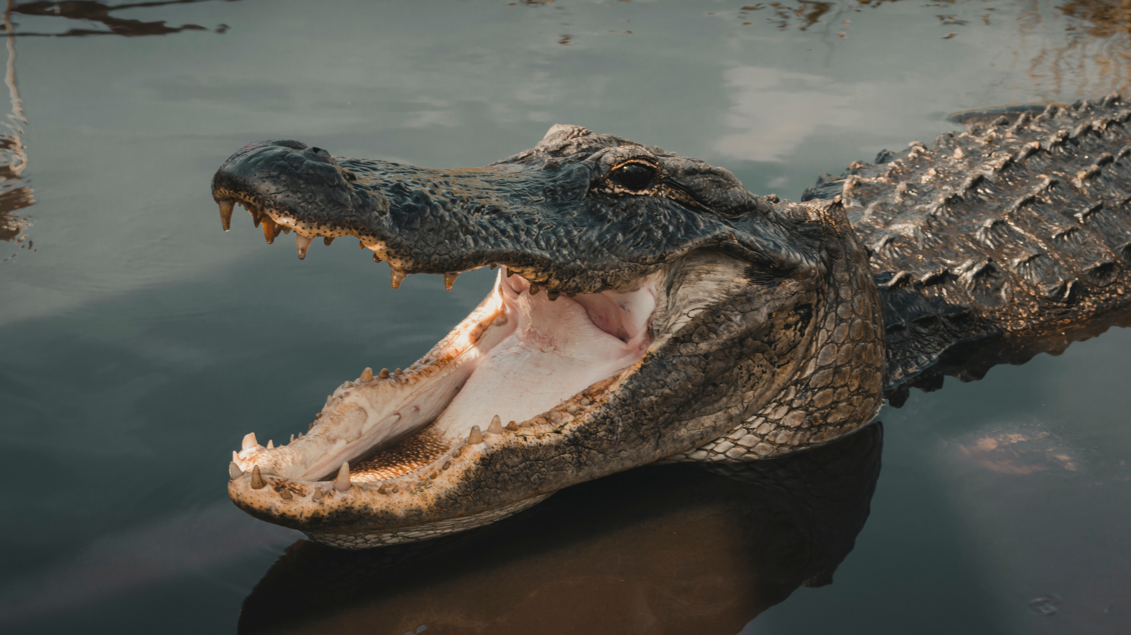
Directions for future development
Insert a reader toggle button that would allow parents to hide the text.
Add screen reader capability that would audibly announce the animal's name that is clicked.
Add more animal classes and species.

Slide 9
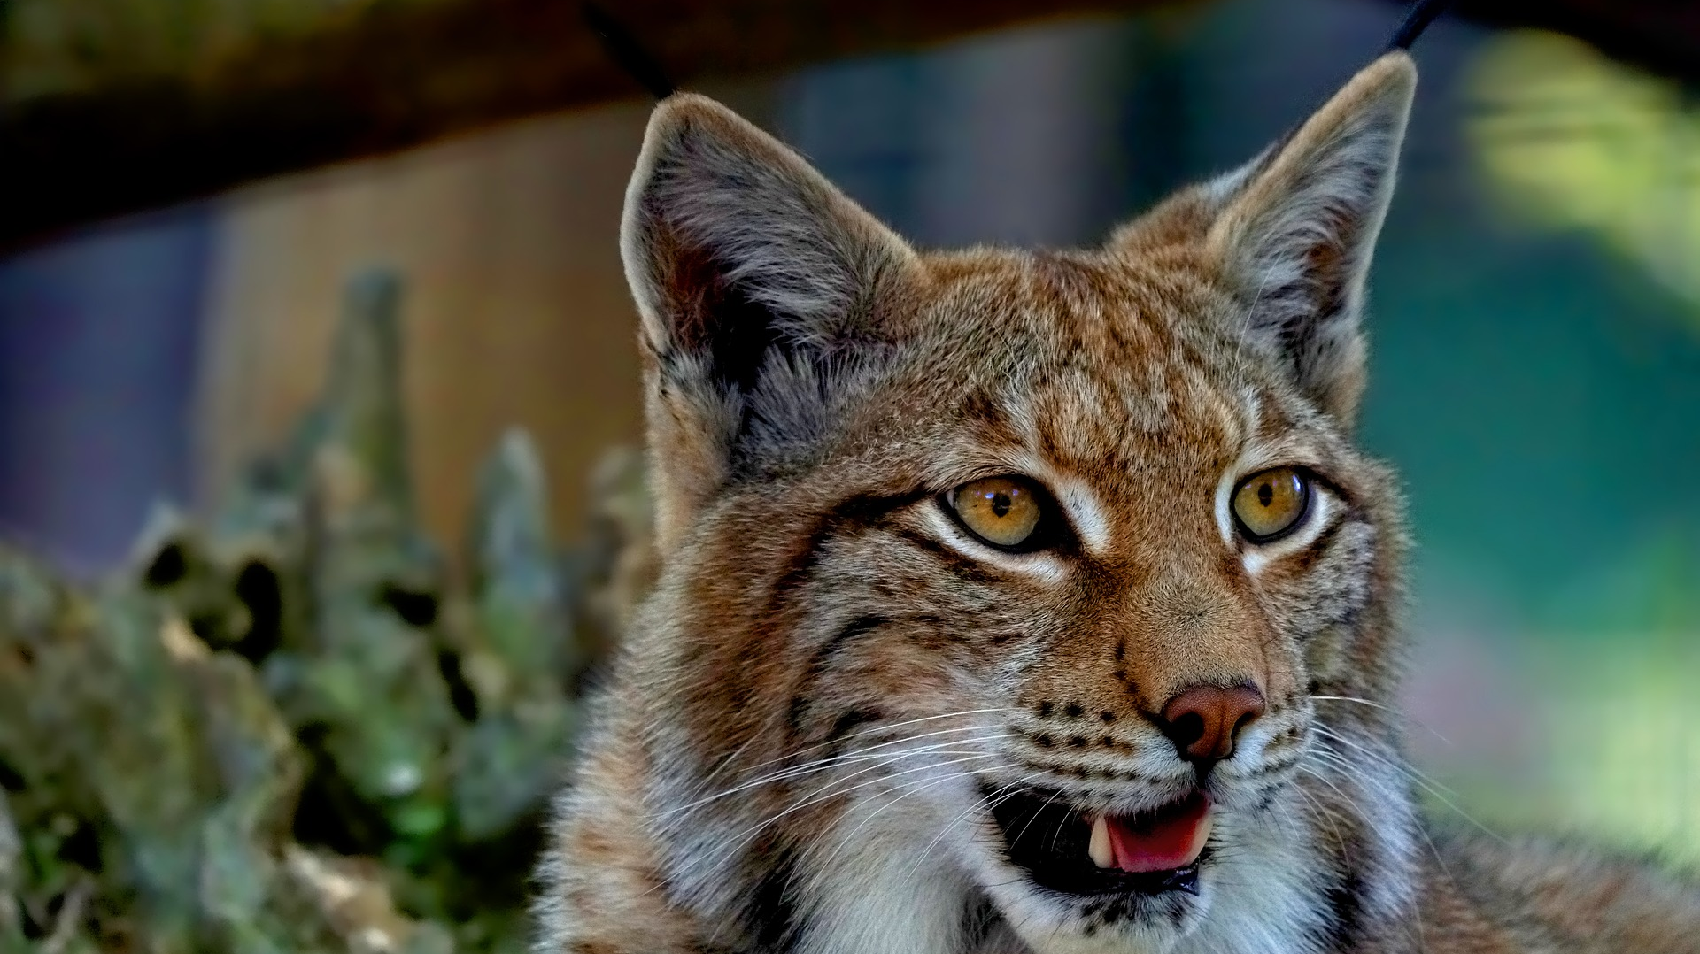
LINKS
GitHub:
https://github.com/ratalla816/animal-app
Deployed application:
https://ratalla816.github.io/animal-app/

